Slide 1



کاربرد Xarray در تحلیل کلان‌ داده‌های زیست‌محیطی
نیما رئیسی
مهدی فرمهینی فراهانی
بهار 1403
دانشگاه خوارزمی

Slide 2


“
Data is the new oil
Clive Humby - 2006

Slide 3


Slide 4
CDS API

Slide 5
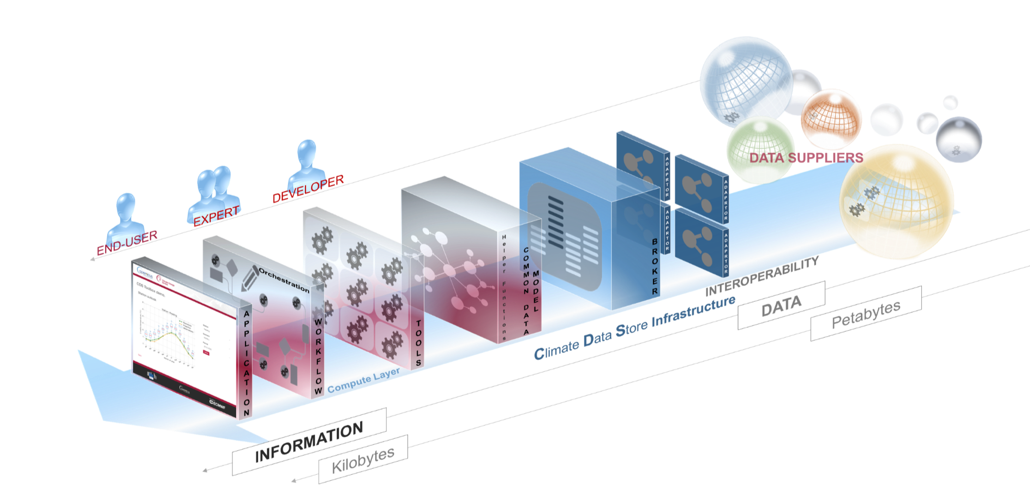
Climate Data Store

Slide 6
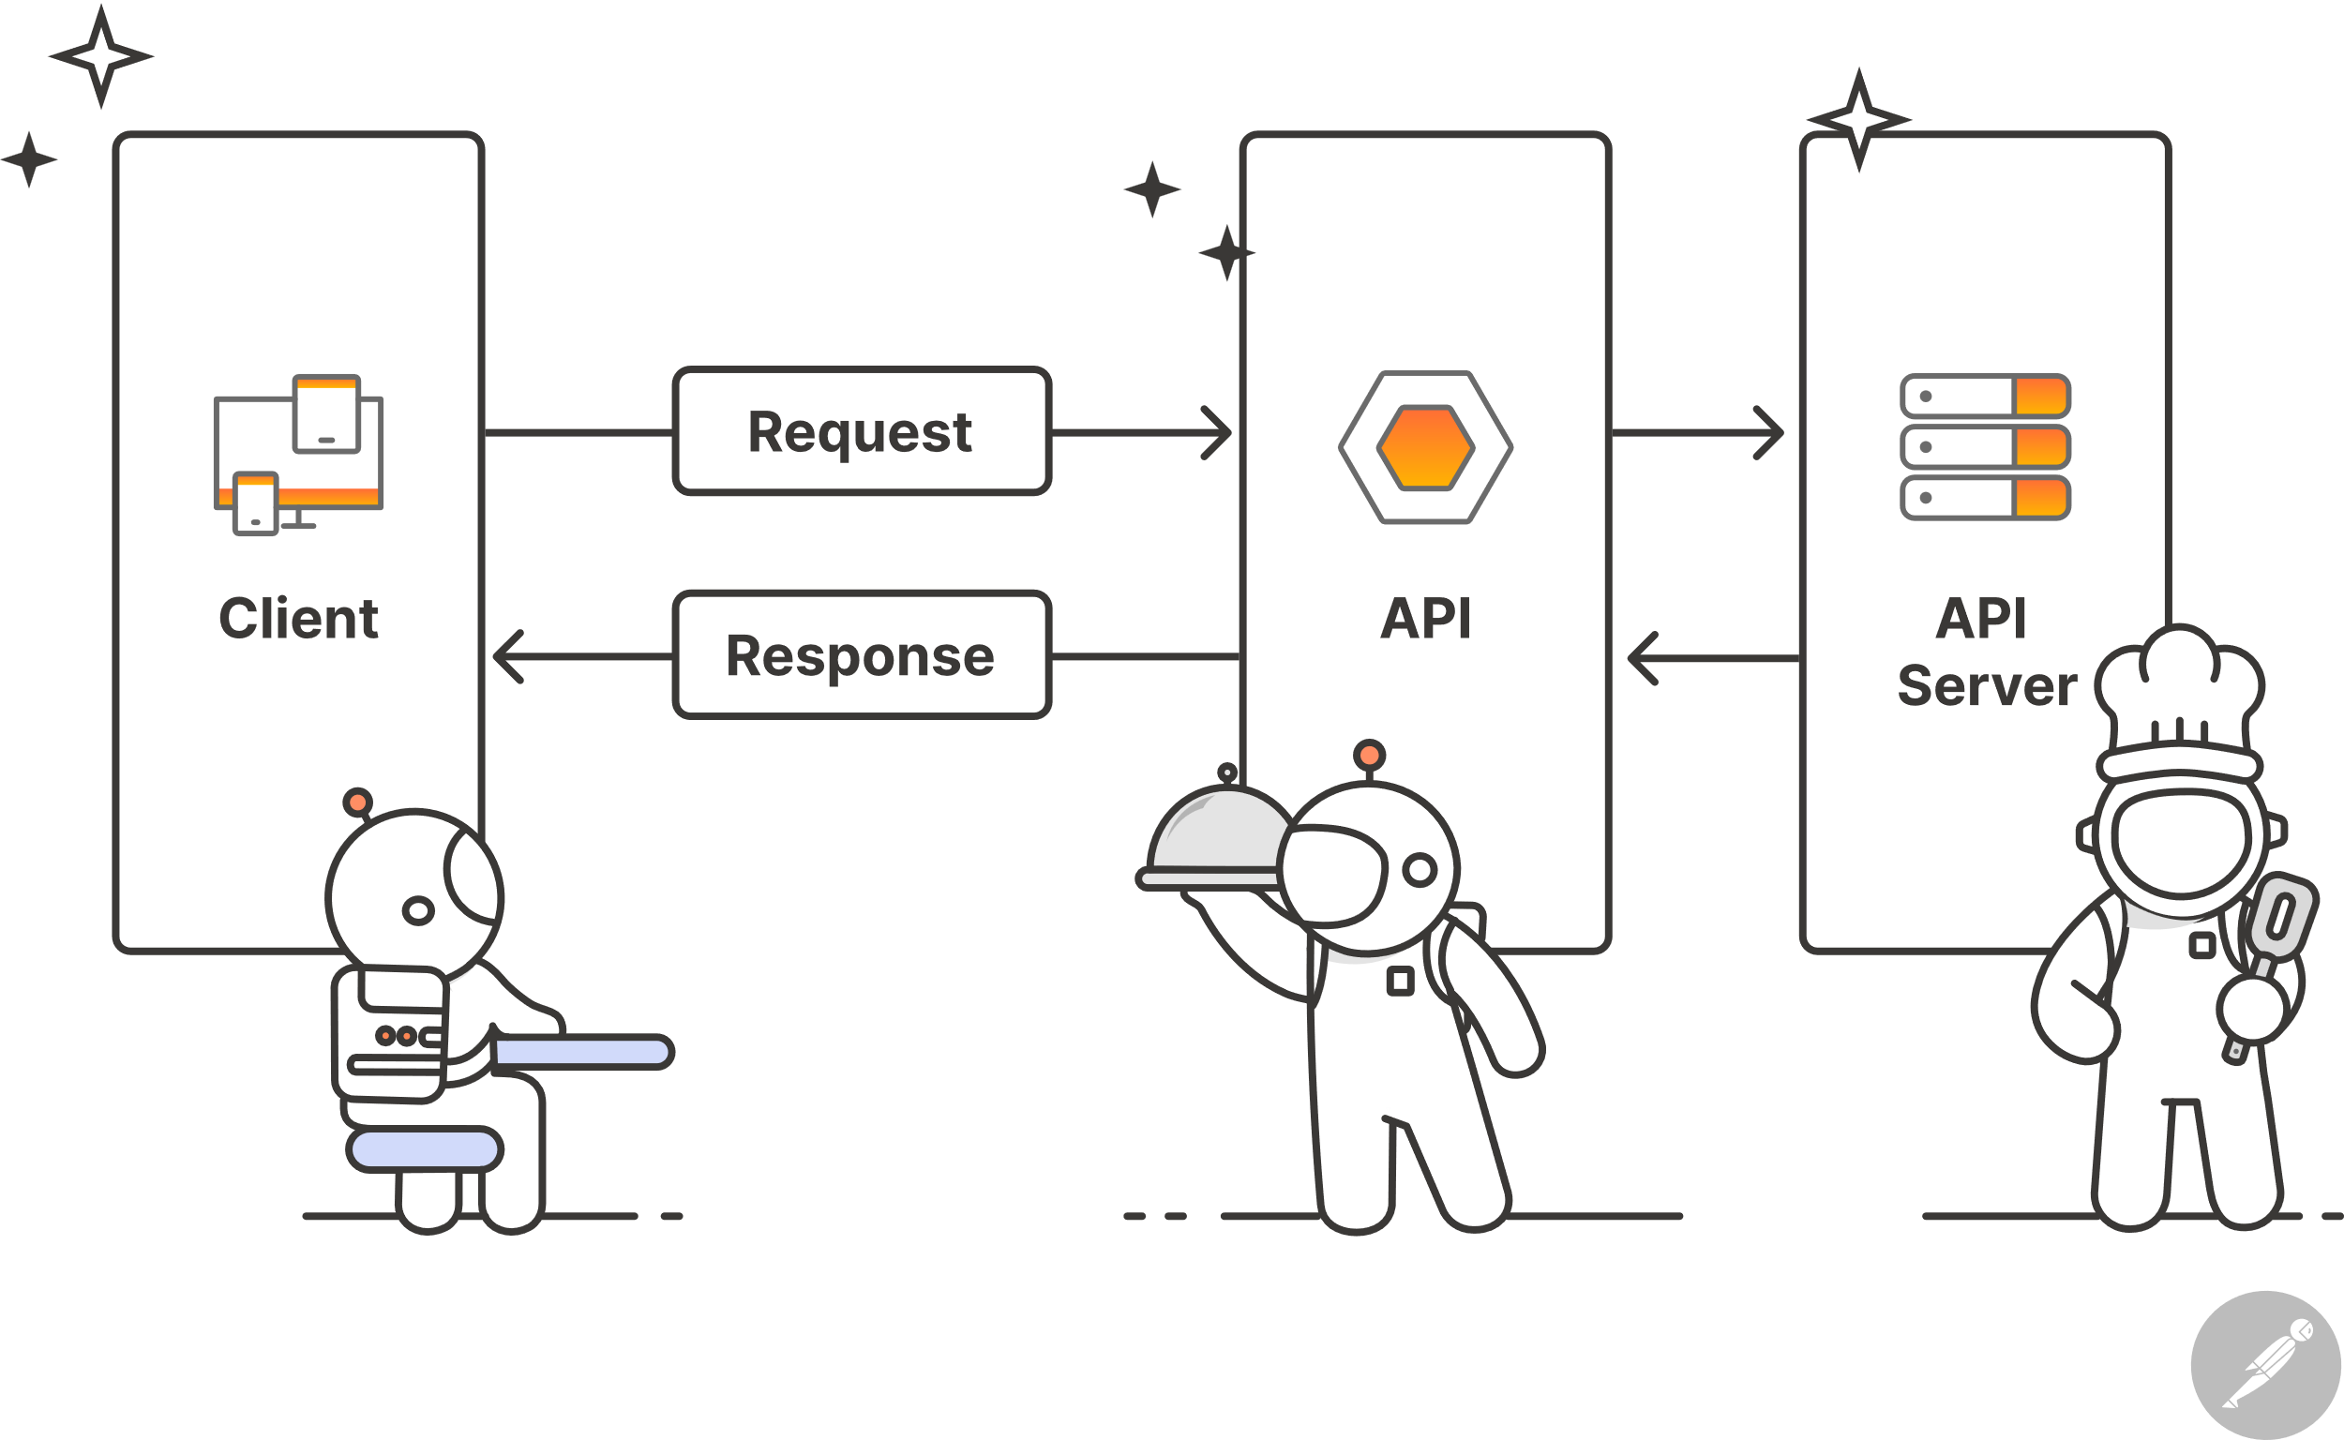
Application Programming Interface

Slide 7
ERA5-land reanalysis dataset
ERA5-Land reanalysis dataset is the European Centre for Medium-Range Weather Forecasts (ECMWF). It’s part of the Copernicus Climate Change Service (C3S) of the European Commission. The ERA5-Land dataset provides high-resolution, hourly data on surface variables and is a replay of the land component of the ERA5 climate reanalysis with a finer spatial resolution of approximately 9km grid spacing. The dataset covers the period from 1950 to the present, with continuous updates to support land monitoring applications. It’s designed to describe the evolution of the water and energy cycles over land in a consistent manner over the production period.

Slide 8
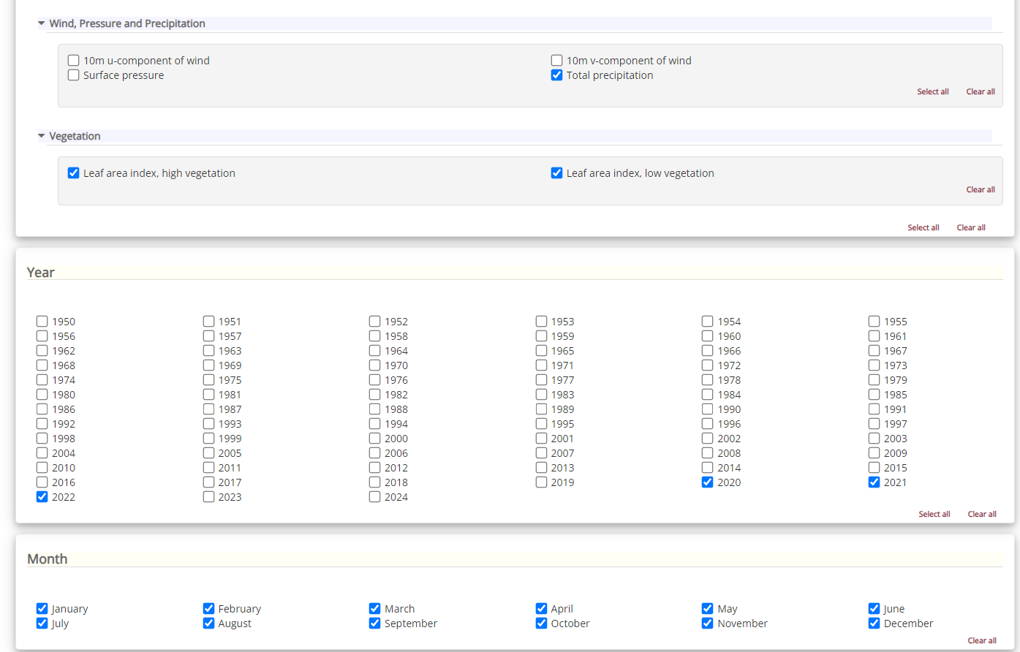

Slide 9
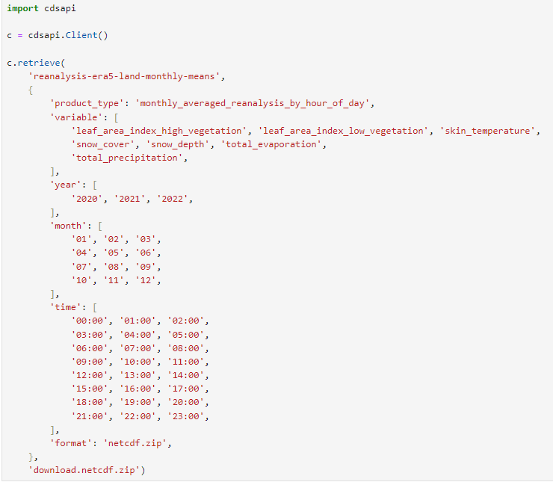
data.nc

Slide 10
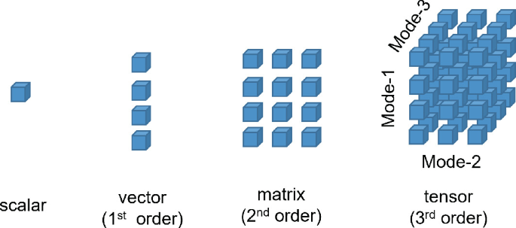

Slide 11
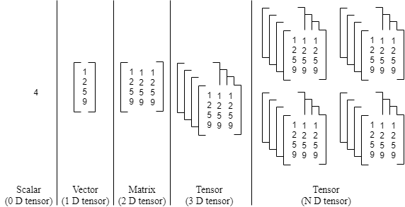

Slide 12
N-dimensional data

Slide 13






xarray

Slide 14
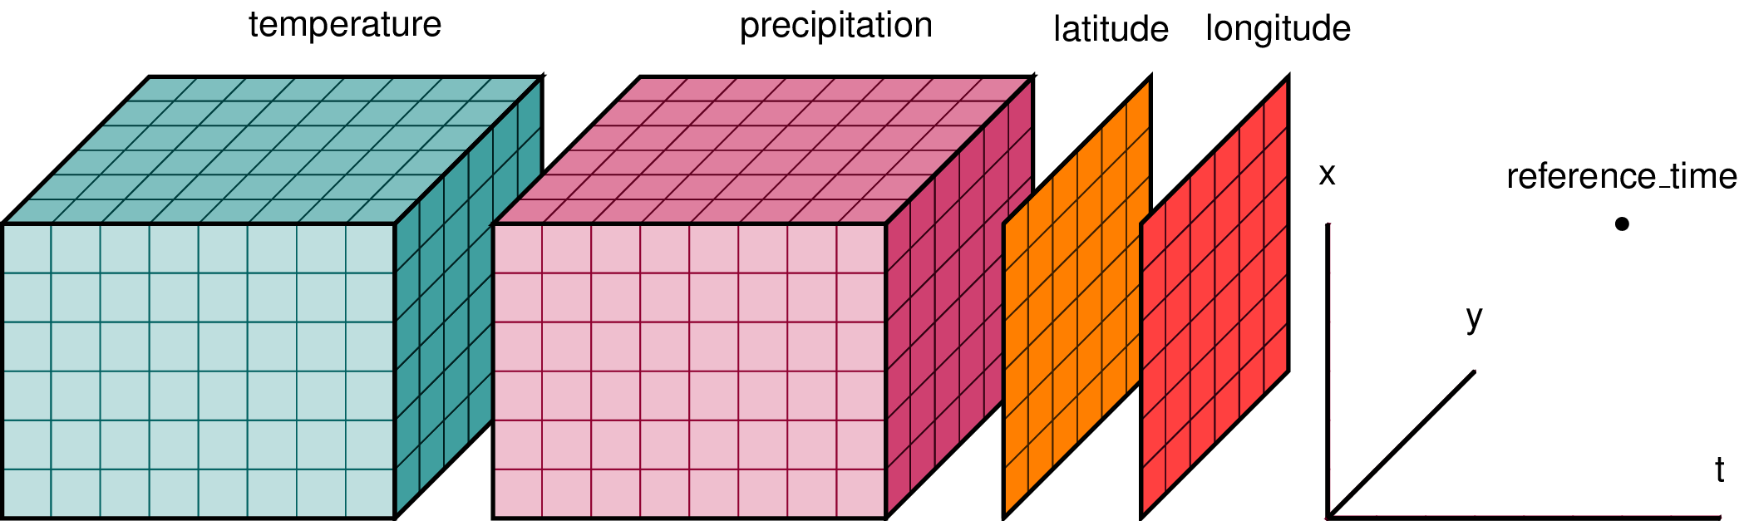

Slide 15
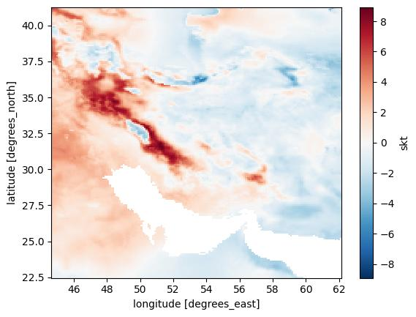
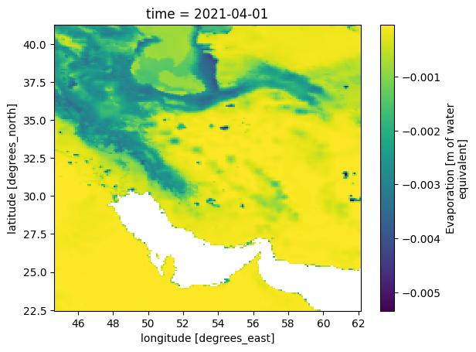
Temperature Change
Total Evaporation on 2021-04-01
2000-2020

Slide 16
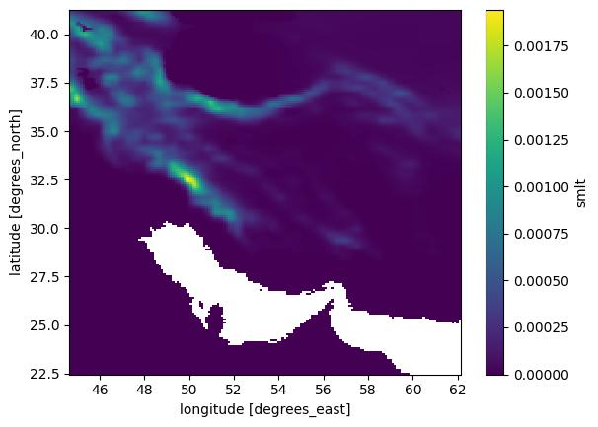
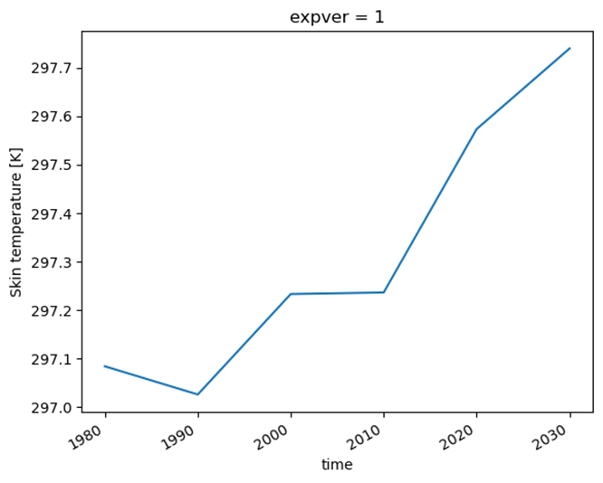
k-Nearest Neighbor
(kNN)
Mean Snowmelt

Slide 17
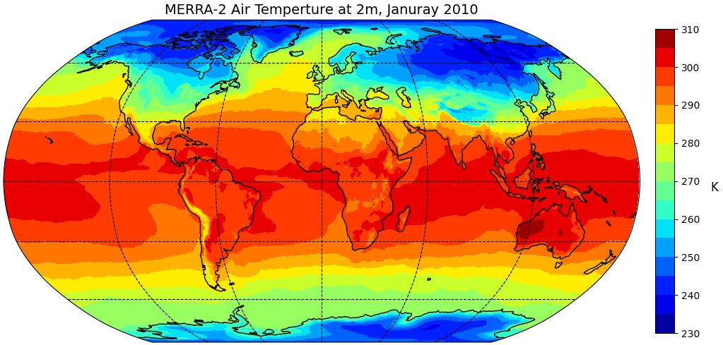

Slide 18
منابع
Hoyer, S., & Hamman, J. (2017). xarray: ND labeled arrays and datasets in Python. Journal of Open Research Software, 5(1), 10-10.
Bourgault, P., Huard, D., Smith, T. J., Logan, T., Aoun, A., Lavoie, J., ... & Whelan, C. (2023). xclim: xarray-based climate data analytics. Journal of Open Source Software, 8(85), 5415.
Post, F. H., Nielson, G., & Bonneau, G. P. (Eds.). (2002). Data visualization: The state of the art.

Slide 19


